Slide 1
Comparison of Clustering Methods using YELP dataset
Angadpreet Nagpal
Azamat Ordabekov

Slide 2
Clustering
Clustering is an unsupervised learning problem for examining the "points" and grouping them into "clusters" according to some distance measure.
We have implemented clustering using the following Algorithms –
Kmeans
Bisecting Kmeans
GMM
Spectral Clustering

Slide 3
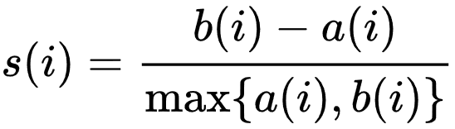
Silhouette value

Slide 4
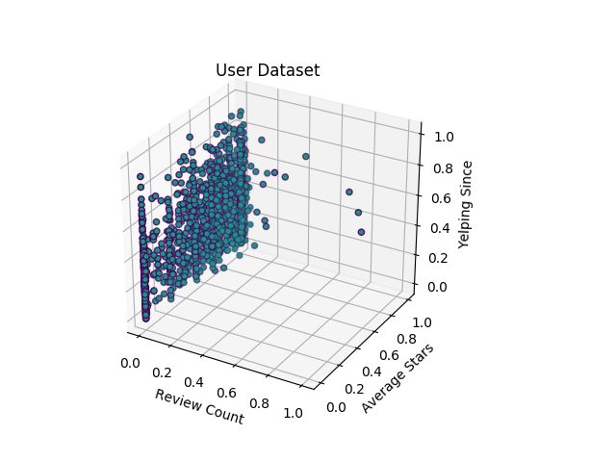
Dataset
User dataset

Slide 5
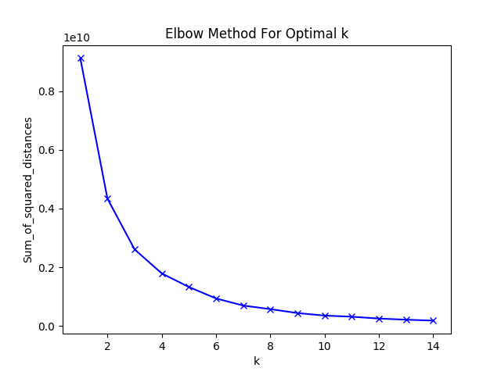
User dataset elbow

Slide 6
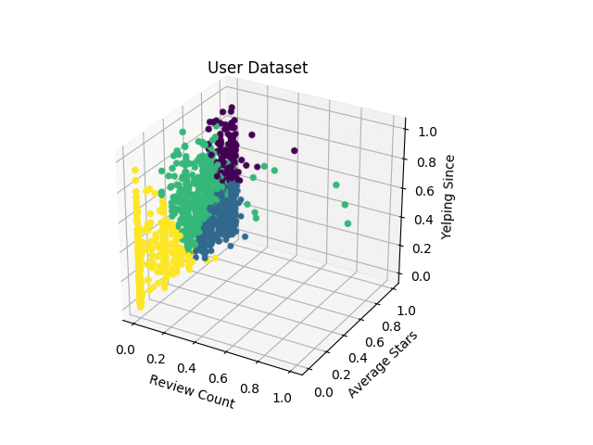
KMeans
Cluster Number | Number of Elements | Per Cluster Silhouette Value
0 | 365 | 0.3609812916531975
1 | 591 | 0.7274430110197224
2 | 402 | 0.526547759149968
3 | 342 | 0.6363682744723312
The silhouette value is 0.58313

Slide 7
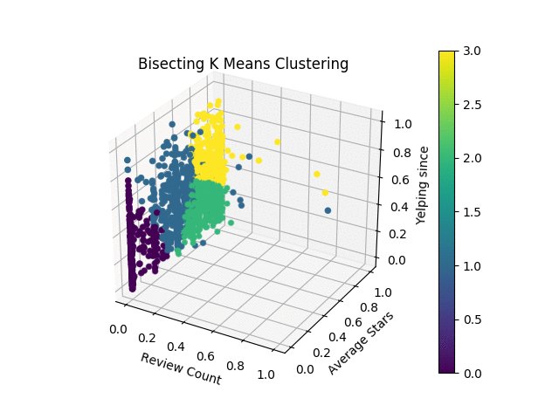
Bisecting KMeans
Cluster Number | Number of Elements | Per Cluster Silhouette Value
0 | 296 | 0.6790278425662956
1 | 385 | 0.4654577037767246
2 | 631 | 0.6843144809683361
3 | 388 | 0.39386802903701135
The silhouette value is 0.567539

Slide 8
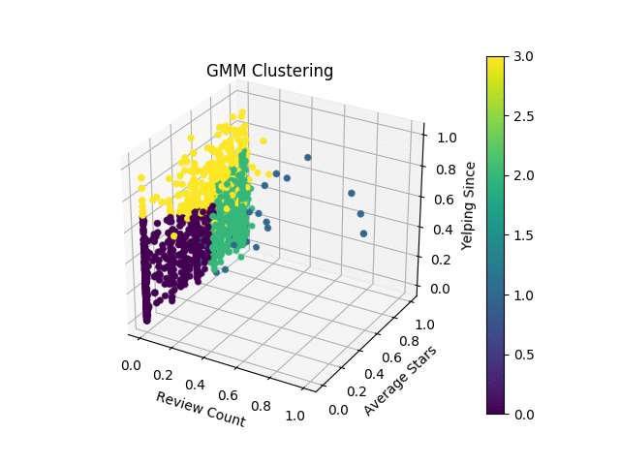
GMM
Cluster Number | Number of Elements | Per Cluster Silhouette Value
0 | 785 | -0.14262559342
1 | 35 | 0.04844638201936253
2 | 503 | 0.6509330427731185
3 | 377 | 0.001801311098826752
The silhouette value is 0.128137

Slide 9
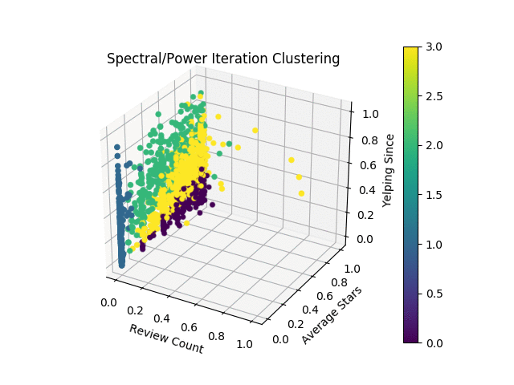
PIC
Cluster Number | Number of Elements | Per Cluster Silhouette Value
0 | 550 | 0.5966287188010183
1 | 707 | 0.05539239260562336
2 | 235 | 0.767223538290254
3 | 208 | 0.10789184330790988
The silhouette value is 0.33532

Slide 10
Initial Comparison
K Means performs the best on the YELP user dataset.
Bisecting K Means gives performance comparable to K Means.
PIC gives good clusters with 0.33 Silhouette value.
GMM performs the worst with 0.13 Silhouette value.
PIC gives the best quality cluster with Cluster 2 having Silhouette value 0.77

Slide 11
Comparison by number of clusters
Number of Clusters | K Means | Bisecting K Means | GMM | PIC
3 | 0.58 | 0.57 | -0.09 | 0.38
4 | 0.58 | 0.56 | 0.13 | 0.34
5 | 0.59 | 0.52 | 0.19 | 0.23

Slide 12
EFFECT of outliers
 | K Means | Bisecting K Means | GMM | PIC
Without Outliers | 0.58 | 0.57 | 0.24 | 0.38
With Outliers | 0.58 | 0.57 | 0.13 | 0.34

Slide 13
cOMPARISON BY ATTRIBUTES
Attributes | Result
average_stars, yelping_since, review_count | 0.58
average_stars, yelping_since (Without review_count) | 0.595
review_count, yelping_since (Without average_stars) | 0.64
average_stars, review_count (Without yelping_since) | 0.76

Slide 14
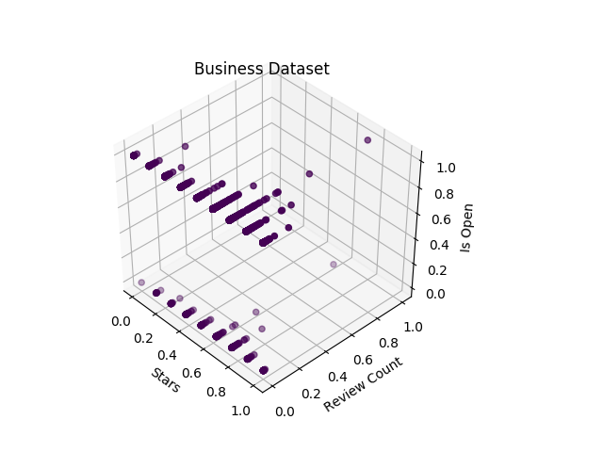
Business dataset

Slide 15
Comparison on Business dataset
 | K Means | Bisecting K Means | GMM | PIC
Silhouette Value | 0.78 | 0.73 | 0.72 | 0.73

Slide 16
Conclusion
K Means operates under the assumption that the dataset should be spherical.
GMM operates under the assumption that the dataset is taken from a Gaussian distribution.
PIC operates under the assumption that the dataset should be similar and have a dominant eigen value.
K Means performs the best on the user dataset with Bisecting K Means not being far behind.
GMM is highly sensitive to outliers affecting the distribution attributes.
PIC is also sensitive to outliers affcting the similarity between the cluster elements.
Time complexity wise, PIC is the most computationally expensive.
Attribute showing the most variation contribute the most towards clustering.
If the dataset conforms to the underlying assumption of the algorithm, it will show very good result.

